Slide 1












ANIco.in
OneClick Go! Version 2.7
How about having a Music Chart of your own? A top 10 hit list... Or a top 300
Something that can help you build it easily ... is here ... OneClick Go!
With OneClick Go!, you get what you wanted since long… We see music charts in Magazines, TV, Blogs and websites but we find ourselves resource less and are just left with criticism/appreciation on their list. No more now…
Promote a song with just one click, maintain your playlist like you always wanted but were too lazy to click a lot. Tell your friends your favorite songs, upload them to your blog/website. Sharing your favorite music was never that easy…
There must be a fence between the songs you want to listen and the songs that you keep as a collection. OneClick Go! helps you build that wall physically… Because ‘My Music’ is the chosen one and ‘All Music’ is just nothing.

Slide 2
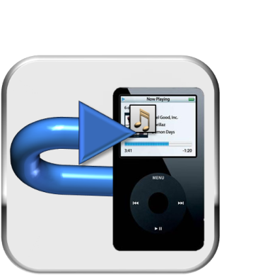
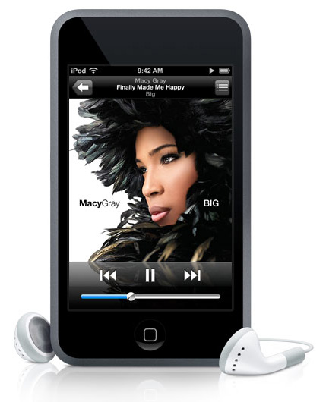
OneClick Go!
Send Music From ANIco.in
How about tracking your super-playlist on the go? Listen to things you want!
Something that can help you have it easily ... is here ... OneClick Go!
With OneClick Go!, sending music to your devices becomes much easier and faster. Get what you worked on your PC directly over your device. Choose the songs you want on your device. And click Send Now and within a minute or so, you are ready to travel with your music.
OCG is compatible with almost every device in this world. So, you don’t have to worry about your American IPod or Japanese Headset. There is only a click between you and your music.

Slide 3

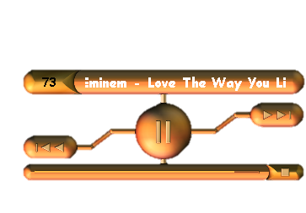
OneClick Go!
Skin Mode From ANIco.in
How about just listening to the music when busy/idle? Listen when you want! Judge how it look! Change with a click!
Something that can help you see it in action ... is here ... OneClick Go!
With OneClick Go!, listening to your music is more comfortable, sophisticated and amusing. See your playlist in action. Choose a skin of your choice. And switch to skin mode. Something that is always on top is your music. Something that doesn’t interfere much but whenever it does, you are always pleased to see it. With all the major controls, the skin mode makes it easy to get the most of your music.
OCG never let you feel the distance between you and your music. Whatever you do, wherever you do, you can always have access to OCG through Hotkeys. Even if you are playing a game, you can change the song from that dungeon, from that battlefield or even from that planet.

